Slide 1
Central Hub Board

Slide 2
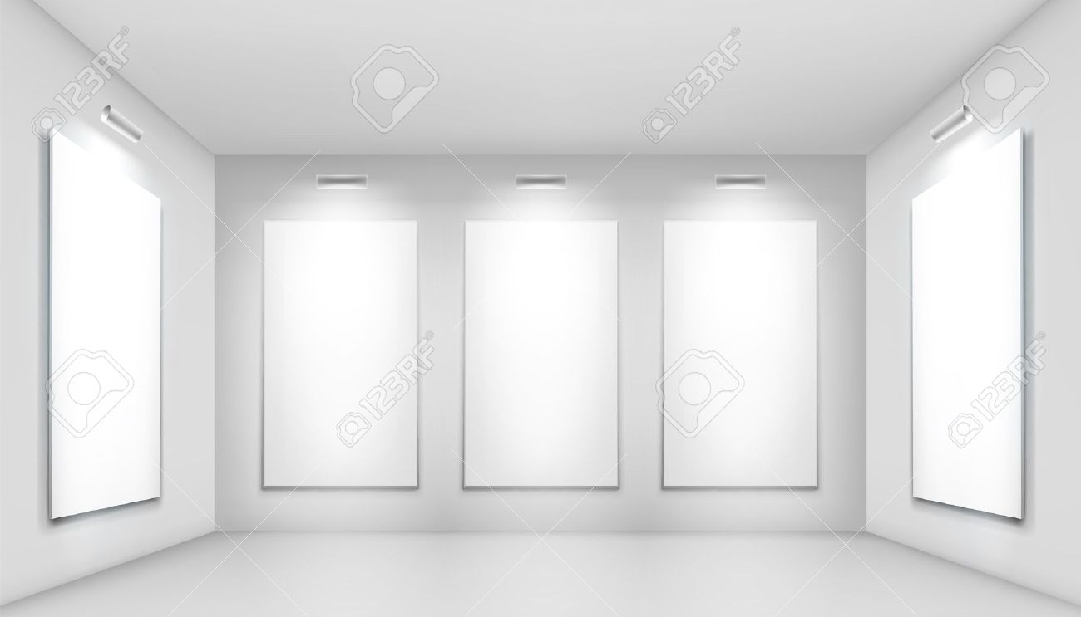
In this picture, it gives off a clean look, untouched how everything is white. It also gives the sense, of starting afresh, from the beginning.
Yet it also means loneliness, as nobody has been there before.

Slide 3
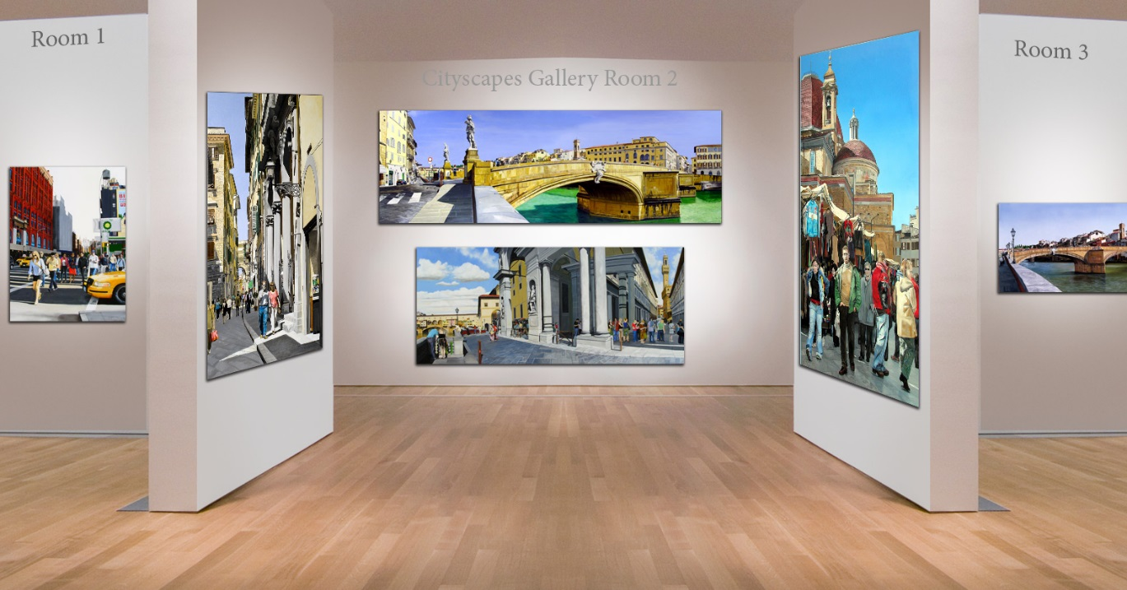
In this photo, the pictures on the wall are all scenery which could mean memories in which our game is about. It is also modern and clean as if it is somebodies house which then means relaxation and calm.

Slide 4
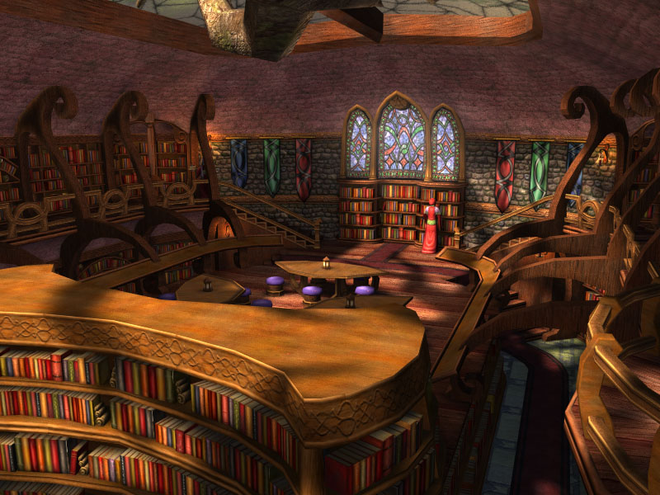
In this picture it is portrayed as a medieval library, as well as colourful and, to me, homely. It gives the impression of safe and full of history and knowledge.

Slide 5
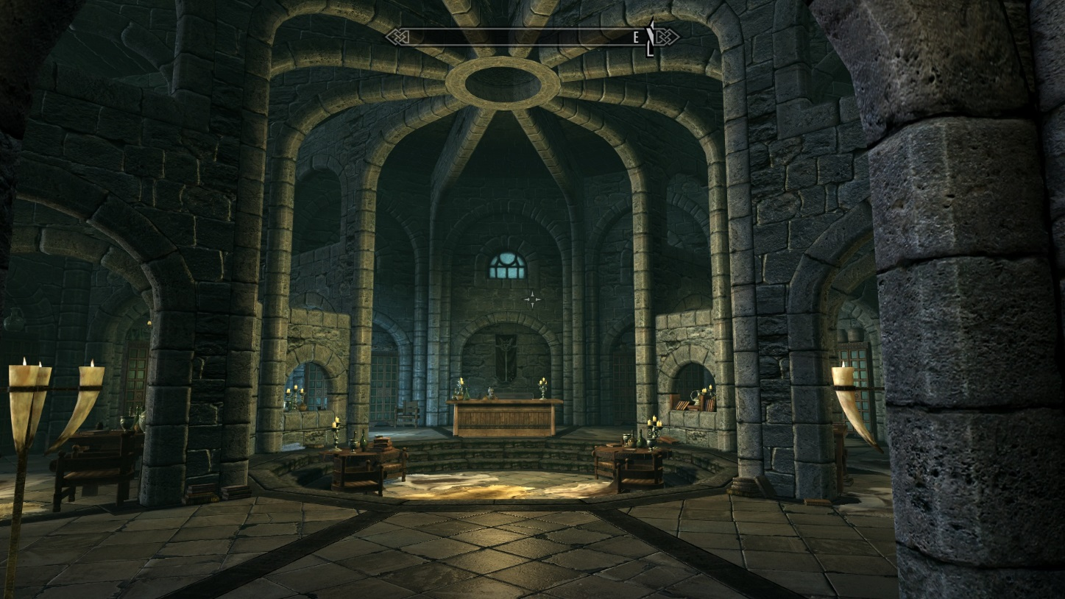
Lastly this picture is a library, once again in medieval times, but it is dark and gloomy, there is little light and as a result gives the impression that it is not safe, it is not decorated in any way, which gives the impression of a prison cell.

